Slide 1
Project review 1
TITLE:TREND ANALYSIS ON GENERATED FEATURES OF ONLINE PRODUCT REVIEWS
PROJECT GUIDES:
D.TEJA SANTOSH
D.VIJAYA LAKSHMI
TEAM MEMBERS:
A.VIVEKANANDA-2210312102
K.VENKATA CHAITHANYA-2210312136
N.SAI SURAJ-2210312147

Slide 2
CONTENTS
1.ABSTRACT
2.INTRODUCTION
3.LITERATURE SURVEY
4.EXISTING SYSTEM
5.PROPOSED THEORY
6.IMPLEMENTATION
7.CONCLUSION AND RESULTS
8.REFERENCES

Slide 3
ABSTRACT
Sentiment analysis or opinion mining is the computational study of peoples opinions, sentiments, attitudes and emotions expressed in written language .Its popularity is mainly for two reasons , firstly whenever we need to make a decision we want to hear others opinion .Secondly, it presents many challenging research problems which had never been attempted before 2000.
Sentiment analysis of a feature captures the orientation of a review in this sense. But, to understand the importance of feature relevance with respect to time, sentiment analysis is extended to tend analysis. Trend Analysis is the extension of sentiment analysis which aims to capture the inclination of the features of a product in the long run.

Slide 4
INTRODUCTION:
Opinion Mining is carried out at Review Level and Statement level successfully but not that much at Feature Level. Opinion Mining requirement is learn opinion orientation for feature. All these techniques take the help of WordNet.
Sentiment Analysis is carried out by many statistical approaches and are successful but very less work as compared to statistical analysis was happened with SentiWordNet. There is a scope to combine benchmark sentiment seed terms with statistical approach and SentiWordNet to find out the sentiment orientation of the review.

Slide 5
LITERATURE SURVEY
Bing Liu has done extensive research in the areas of Opinion Mining and Sentiment Analysis
[https://www.cs.uic.edu/~liub/FBS/NLP-handbook-sentiment-analysis.pdf].
Sir Tim Berners Lee, father of World Wide Web has done enormous research in RDF and SPARQL
[http://tomheath.com/papers/bizer-heath-berners-lee-ijswis-linked-data.pdf]

Slide 6
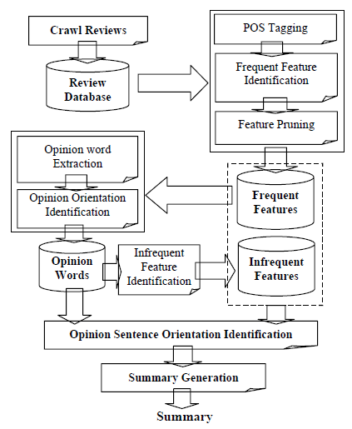
Existing system

Slide 7
PROPOSED THEORY

Slide 8
IMPLEMENTATION:
STEP-1: XML Processing:
There will be an XML file created for storing all the features of any particular product that is available readily on the internet. In this Step the XML file that contains all the features of the product are processed to extract the features excluding all the XML tags.
The XML file containing the features of the product are given as input to the program.
The program processes the XML file for the value present in the set of tags.
Then the program excludes the tags and then extracts the values present between the tags which become the actual features of the product.
Now, the program creates a text file for storing the features.
The features that are extracted are stored in the text file that is created.

Slide 9
Step-2: Pre –Processing:
All the stop words present in a given input text file which consists of selected product reviews are removed.
The text file that contains all the selected product reviews is given as input to the program.
The program processes the text file and then splits each word of the file.
Each word of the file is compared with the set of stop words.
If the word that is present in the file is a stop word, then it is eliminated.
Since all the stop words are removed the resultant file has no stop words.
The program creates a file and then writes all the reviews that do not contain the stop words.

Slide 10
Step-3: Parts of speech tagging:
Each word in the text file is tagged with the respective parts of speech.
The output text file from the step-2 is given to the step-3 for parts of speech tagging.
In this step the Stanford-postagger.jar file is used to tag the parts of speech of any given text.
The .jar file can be accessed by using a command in the command prompt.
The command is embedded in a java program and use process builder that opens the command prompt and directs to the path that is given where the Stanford-POStagger is present.
The Stanford-POStagger hence tags the content of the text file containing the reviews.
The output is then written to a text file.

Slide 11
Step-4: Discretization:
The adjectives and nouns that are present in the tagged file are separated and stored in two different files.
The output file from step-3 is dynamically given to step-4 for discretization.
The Nouns and Adjectives that are present in the tagged file are separated in this step.
The program checks each element of the file and then retrieves the nouns in the file.
The Nouns that are retrieved are stored in a text file that is created by the program.

Slide 12
Step-5: Frequent Noun Generation:
The frequently repeated Nouns are identified and stored in a file.
The Nouns file from step-3 is dynamically given to step-4 for generating frequent Nouns
The Nouns that are repeated thrice or more than thrice are identified in this step.
The nouns are compared with themselves and the number of times the nouns are repeated calculated.
Depending on the repetitions of the noun, the nouns that are repeated more than thrice are retrieved which are called the frequent nouns.
The frequent nouns that are retrieved are stored in a text file.

Slide 13
Step-6: Relevant Noun Generation:
The nouns that are relevant to the product features are extracted.
The Frequent nouns that are generated in step-5 and the Actual features that are generated in step-1 are dynamically given to step-6 for generating Relevant nouns.
The actual features are compared with the frequent features and the relevant features are retained eliminating the unwanted and irrelevant features.
The relevant features thus generated are then written to a text file by the program.

Slide 14
Step-7: Sentiment word extraction:
In this step, sentiment of the generated nouns and adjectives are retrieved in this Step with the help of SentiWordNET.
The relevant features that are retrieved by processing the reviews are then compared with the corresponding adjectives that are generated in the step-3 from the reviews.
The adjectives are checked for the sentiment using the SentiWordNet tool which consists of the sentiments and meanings of the words.
The determination of the sentiment of the adjectives is done manually.
The sentiment values are noted down in an excel sheet for further reference.

Slide 15
Step-8: Trend Analysis:
In this step the sentiment values which are calculated using Senti WordNET are processed and the trending features are identified.
The sentiment values that are noted down in the excel sheet are processed.
The number of positive, negative and neutral values for each feature are then noted down into another excel sheet and their average values are calculated.
Using appropriate settings, we draw a horizontal bar graph.
The bar graph contains the feature and the corresponding number of negative and positive scores in graphical format.
Since the average of the values are known we set the average value as a threshold value.
The features that have positive count equal or more than the threshold value are considered as trending features.

Slide 16
CONCLUSION AND RESULTS
Explicit online customer reviews on a product are processed in such a way that they are repaired, tokenized, preprocessed, their parts of speech are known and only frequently discussed relevant features in the review set are mined using different algorithms. The reviews which have relevant frequent features are considered for sentiment analysis. sentiments are extracted from the reviews using sentiword.net. And then Trend analysis of the product is extracted.
In future, more work is needed on further refining techniques mentioned in this project and to deal with the outstanding problems like subjectivity classification, word sentiment classification based on machine learning techniques and opinion extraction problem. A variety of steps can be taken to expand this work further by creation of categories for sentiment word senses, where the SentiWordNET is mined for categories of word senses which are particular to products and make the sentiment analysis much easier and reduce the manual work done.

Slide 17
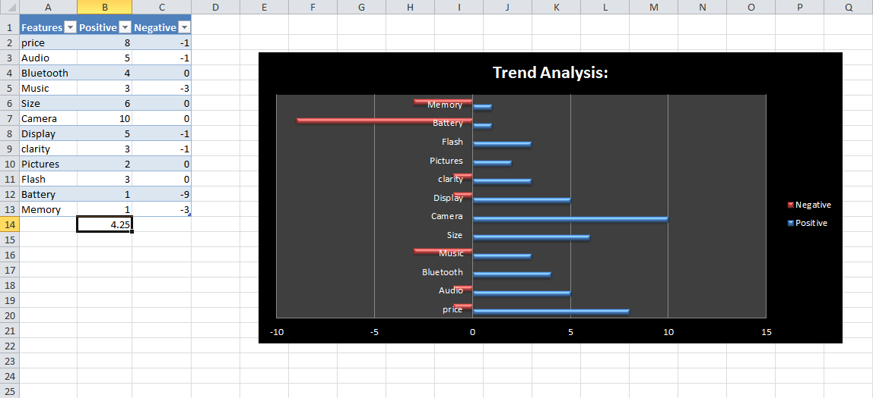

Slide 18
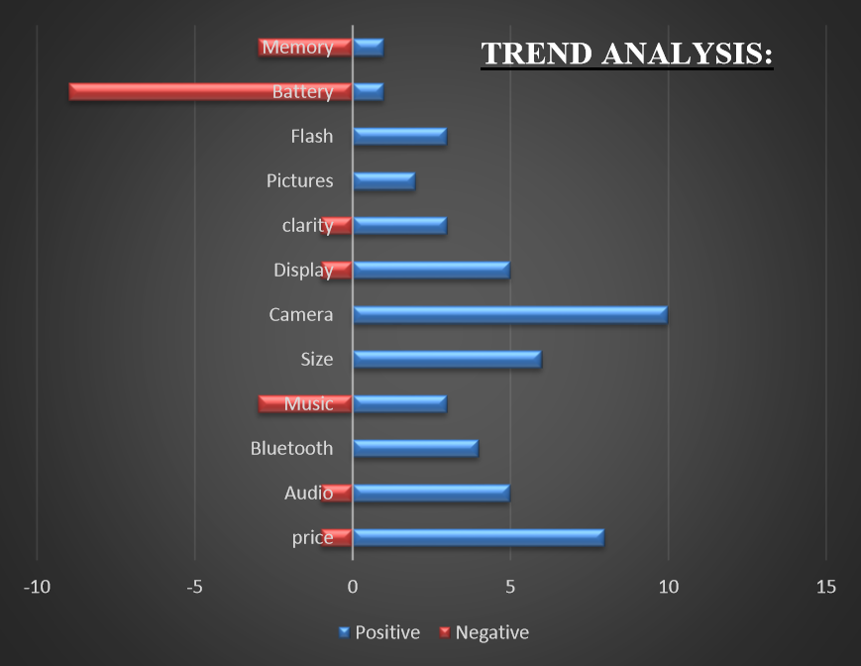

Slide 19
REFERENCES:
Aspect and Entity Extraction for Opinion Mining-Lei Zhang and Bing Liu.
A survey on sentiment detection of reviews-Huifeng Tang, Songbo Tan, Xueqi cheng.
Stop Word List: -- http://xpo6.com/list-of-english-stop-words/.
SentiWordNET source: -- http://sentiwordnet.isti.cnr.it/
Obtaining feature and sentiment based linked instance RDF data from unstructured reviews using ontology-based machine learning --D. Teja Santosh, B. Vishnu Vardhan.
http://nlp.stanford.edu/software/tagger.shtml
http://nlp.stanford.edu/software/pos-tagger-faq.shtml#b

